Slide 1
THANTHAI PERIYAR
GOVERNMENT INSTITUTE OF TECHNOLOGY,VELLORE-632002
DEPARTMENT OF COMPUTER SCIENCE AND ENGINEERING
YEAR/SEM:III/VI
SHAFEEQ AHMED Z
513121104039
Shafeeqahmed.zcse2021@gmail.com
Final Project
DEMO LINK:https://drive.google.com/drive/folders/1e-0ftE1c72eb0SR3FhxZgDQ8gJqo0Bnv?usp=sharing

Slide 2
PROJECT TITLE
Image Interpolation and Reconstruction using ProGAN

Slide 3


OUTLINE
PROBLEM STATEMENT
PROPOSED SOLUTION
SYSTEM DEVELOPMENT APPROACH
ALGORITHM AND DEPLOYMENT
RESULT
CONCLUSION
REFERENCES
3/21/2024 Annual Review

Slide 4

PROBLEM STATEMENT
Generating high-quality images with smooth transitions between different latent space vectors is essential for various applications like image editing, style transfer, and content generation. However, achieving such smooth transitions and accurate reconstructions remains a challenge.

Slide 5
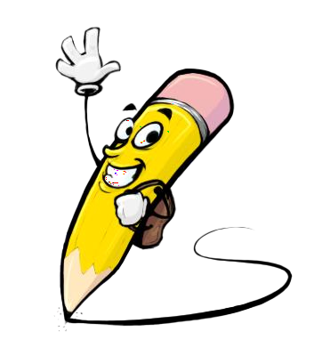
PROPOSED SOLUTION
This project aims to utilize Progressive GANs (ProGANs) to interpolate between latent space vectors and reconstruct images from them. The approach involves interpolating between two random vectors in the latent space and reconstructing intermediate images. Additionally, it explores finding the closest latent vector to a target image and reconstructing it using optimization techniques.

Slide 6
SYSTEM DEVELOPMENT APPROACH
Hardware Requirements:
CPU: A multi-core processor (preferably quad-core or higher) to handle the computational workload efficiently.
GPU (Graphics Processing Unit): While not strictly necessary, having access to a GPU, especially NVIDIA GPUs with CUDA support, can significantly accelerate the training and inference processes, particularly for deep learning tasks like those involved in this project.
Memory (RAM): At least 8 GB of RAM is recommended, although having 16 GB or more would be beneficial, especially when working with large datasets or models.

Slide 7
SYSTEM DEVELOPMENT APPROACH-CONT
Python Environment:
Python 3.3: The code provided appears to be compatible with Python 3.3 and more.
Python Libraries:
TensorFlow: For deep learning tasks, including working with pre-trained models like ProGANs.
TensorFlow Hub: Required to load the ProGAN model from TensorFlow Hub.
imageio: For creating animations and reading/writing images.
scikit-image: Used for image processing tasks.
Matplotlib: For data visualization, particularly plotting loss curves.
Other standard Python libraries: absl, PIL, numpy, etc.

Slide 8
SYSTEM DEVELOPMENT APPROACH-CONT
3.Development Environment:
Google Colab can be used for interactive development, experimentation, and documentation.
while other development environments like pycharm, pytorch, anaconda can also be used.

Slide 9

ALGORITHM AND DEVELOPMENT
Initialization:
Install required libraries.
Define utility functions for interpolation, image display, animation, etc.
Interpolation between Vectors:
Interpolate between two random vectors while ensuring smooth transitions on the hypersphere.
Generate images using ProGANs for each interpolated vector.
Create an animation to visualize the interpolation process.

Slide 10
ALGORITHM AND DEVELOPMENT-CONT
3.Image Reconstruction from Latent Space:
Generate a random vector in the latent space.
Reconstruct the image corresponding to the vector using ProGANs.
Display the reconstructed image.
4.Optimization-based Reconstruction:
Define an optimization process to find the closest latent vector to a target image.
Optimize the latent vector to minimize the difference between the reconstructed image and the target image.
Display the optimization process and the final reconstructed image.

Slide 11
ALGORITHM AND DEVELOPMENT-CONT
5.Deployment:
Deploy the code on suitable platforms like Colab, allowing users to interactively explore image interpolation and reconstruction.

Slide 12

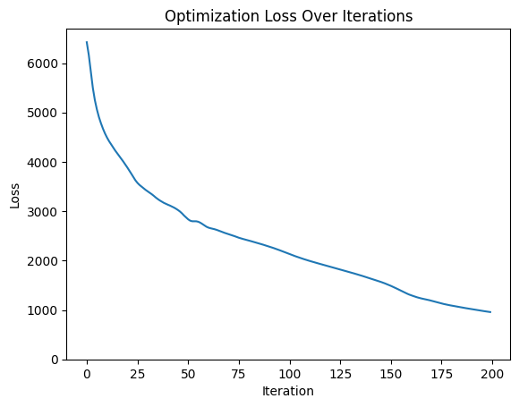
RESULT
Smooth interpolation between two random vectors, generating high-quality images with smooth transitions.
Accurate reconstruction of images from latent space vectors.
Successful optimization-based reconstruction, producing images close to the target image.
3/21/2024 Annual Review

Slide 13
CONCLUSION
This project demonstrates the effectiveness of using ProGANs for image interpolation and reconstruction tasks. It provides insights into generating smooth transitions in the latent space and accurately reconstructing images from latent vectors. The optimization-based approach further enhances the capability to reconstruct images close to given targets.

Slide 14
REFERENCES
Progressive GANs (ProGANs) - TensorFlow Hub
https://imageio.readthedocs.io/
https://www.tensorflow.org/hub
https://github.com/tensorflow/docs

